Slide 1
BASICS OF MongoDB and CRUD
Rahul
161126

Slide 2
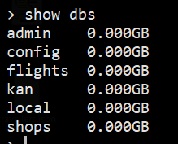
show dbs

Slide 3

To switch to or create a database

Slide 4
InsertOne Command

Slide 5
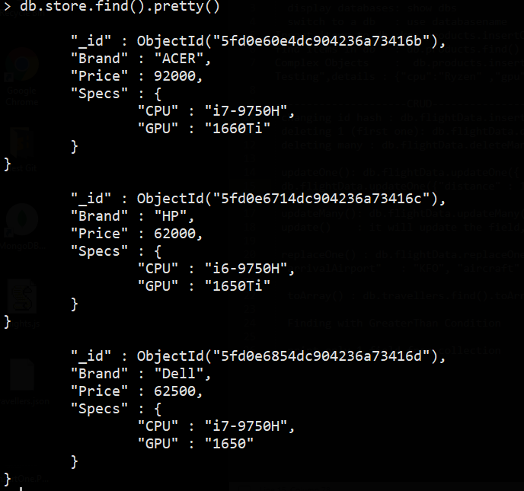
Read All

Slide 6
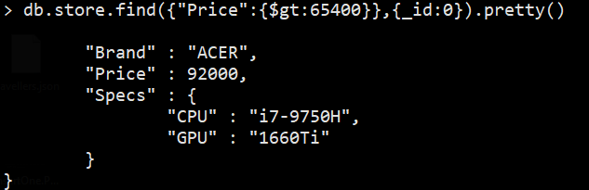
Read with Condition with Not printing _id

Slide 7
Update One with Brand Condition

Slide 8
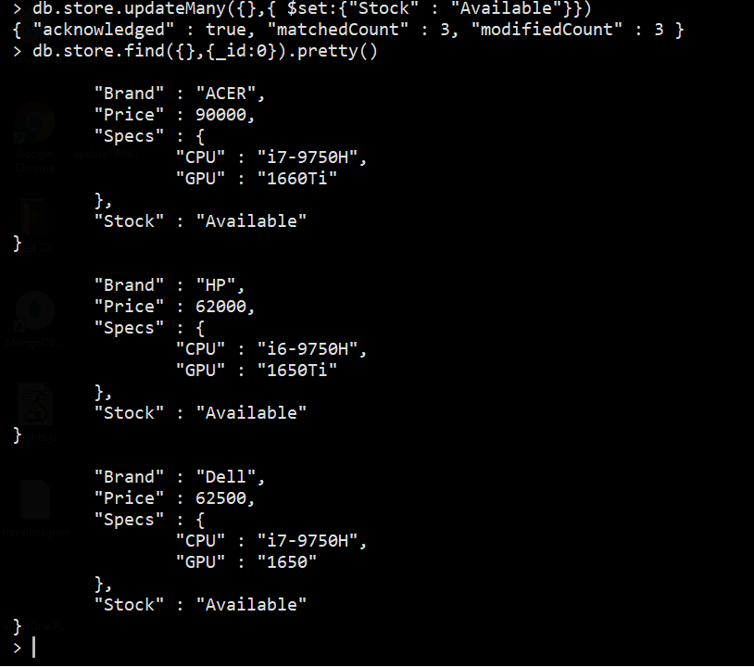
updateMany with Condition

Slide 9
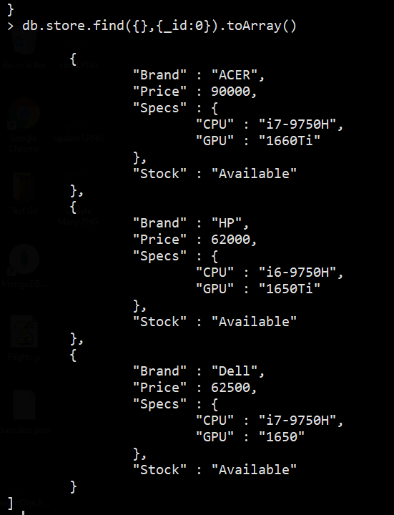
Display with toArray()

Slide 10
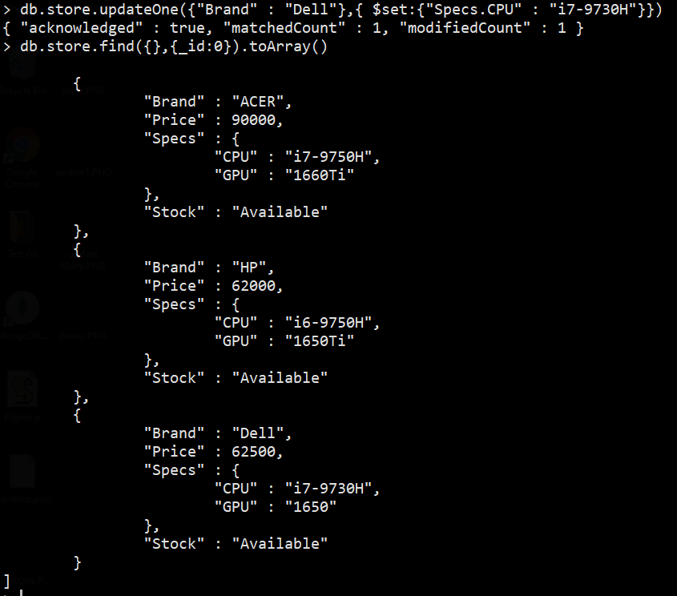
MultiLevel Updating

Slide 11
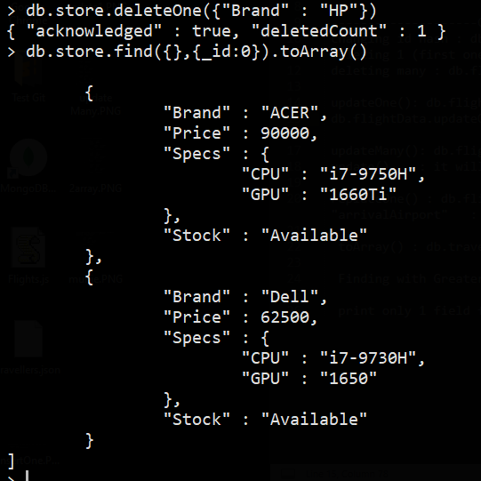
DeleteOne with Condition

Slide 12
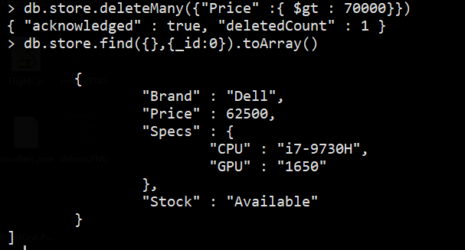
deleteMany with Condition

